Slide 1


A CX-Driven AI Learning Platform Makeover
Pravin Rajnale

Slide 2
Why This Matters – The Shift Towards AI-Centric Learning Experiences
Global e-learning market to hit $400B by 2030; AI-driven personalization is now a baseline expectation.
Intent
Identify what works, what’s broken, and how to leapfrog competition.
AI & ML Based Algorithm
Sentiment Engines
Data Inter-linking Algorithms
Man-in-the Loop Investigations
Product teardown of Coursera (Tasks 1–3)
Competitive & business opportunity mapping (Task 4)
ImmverseAI LMS redesign blueprint (North Star Task)
Scope
AI isn’t just an add-on in learning it’s becoming the new interface between students and knowledge.

Slide 3

Coursera – A Mature Benchmark in AI-Enabled Learning
Target Audience
#1
Students, professionals, corporates, governments.
Value Proposition
#2
Access world-class education from anywhere, anytime, with recognized credentials.
AI & ML Based Algorithm
Sentiment Engines
Data Inter-linking Algorithms
Man-in-the Loop Investigations
Core Stats
#3
92M+ learners, 7,000+ courses, 1,500 guided projects, 40+ degrees.
275+ partner universities & companies (Google, Meta, Stanford).
Languages: 60+.
Pricing: Freemium → Coursera Plus → Degrees.
Technical Differentiators
#4
ML-driven recommendation engine (collaborative + content-based).
NLP-powered grading for open-ended assessments.
Coursera shows that credibility + scalability + AI-driven personalization is the winning triangle in modern EdTech.

Slide 4
User Journey
Discovery
Tracking
Semantic search (NLP embeddings) + multi-filters.
Progress dashboards & predictive nudges.
Simple sign-up → goal selection → AI suggests tailored courses.
Video + quizzes + guided projects + peer discussions.
AI grading → certificate issuance → AI suggests next course.
AI & ML Based Algorithm
Sentiment Engines
Data Inter-linking Algorithms
Man-in-the Loop Investigations
Onboarding
Learning
Completion
Observations
AI recommendations reduce decision fatigue (bounce rate drops ~22% when used).
Peer forums improve trust but engagement is inconsistent.

Slide 5
Engagement Levers
Top 3 Features Driving Engagement
Feature | Why Effective | Measurable Impact
AI-Personalized Recommendations | Matches user skill gaps & goals | +25% start rate
Guided Projects/Labs | Real-world application of concepts | +32% retention
AI Subtitles/Translations | Multi-language accessibility | +40% reach
Observations – Pain Points
Business Risk
Low Completion Rates - 15% avg.
Limited Real-Time Interaction - ~80% of courses are self-paced (asynchronous), with minimal live engagement.
Content Overload - 7,000+ courses create choice paralysis.
Every 5% drop in completion → 3% drop in subscription renewals.
Lack of real-time support → ~20% mid-course churn.
When content is relevant, practical, and linguistically inclusive, learners stay longer and complete more.

Slide 6
AI Features & Impact
AI Feature | Technical Function | CX & Business Impact
Personalized Recommendations | Collaborative filtering + NLP content mapping | ↑ Engagement (+1.3x completion)
Automated Feedback | LLM + domain rubrics for grading | Instant turnaround; consistent quality
Adaptive Nudges | Predictive models detect inactivity | 8–10% dropout rate
AI Translation | Neural Machine Translation with context tuning | Expanded market reach by ~40%
AI is strong at discovery & grading but weak in real-time, in-context support.
Proposal
Projected Gains
LLM-Powered AI Learning Coach
Embedded in course player.
Contextual Q&A based on current lesson.
Adaptive practice & revision scheduling.
Completion rate ↑ +25–30%
Net Promoter Score ↑ +12
Churn ↓ -20%

Slide 7

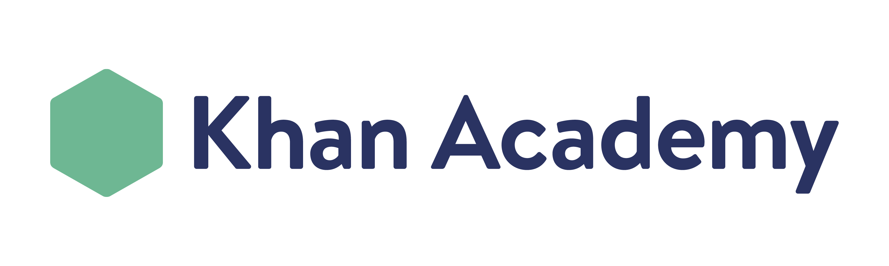

Feature Comparison Summary

Slide 8
Competitive Analysis
Criteria
Credential Value | High | Low–Medium | Low
AI Personalization | Strong | Weak | Minimal
Hands-On | High | Variable | Medium
Completion Rate | 15% | 7–10% | 35%
Coursera leads on trust and AI but loses to gamified platforms in keeping learners consistently engaged.
Monetization & Growth Opportunities
Projected Gains
Potential Levers:
Micro-Credentials Marketplace: Short, verified skill badges ($10–$50).
AI Tutoring Add-On: $15/month for 24/7 AI coach.
Corporate Skills Benchmarking: B2B up-sell analytics.
Localized Partnerships: Expand in Asia & Africa.
Gamified Premium Track: Points, streaks, leaderboards.
Skill Path Challenges
30-day themed journeys (e.g., “Data Science in 30 Days”).
AI nudges, peer accountability, milestone rewards.
Impact:
Completion ↑ +25%
Subscription retention ↑ +15%

Slide 9
LMS: Vision
Target: High School & College Students.
Top 3 AI-First Features:
AI Study Coach: Real-time LLM tutor with knowledge graph for contextual accuracy.
Adaptive Skill Tracks: ML adjusts difficulty & content format based on learner performance.
Gamified Social Learning: XP points, badges, leaderboards, team challenges.
New Feature: AI Study Coach
User Flow:
Login
Dashboard
Select Course
Lesson Player with AI Coach
Ask Questions/Get Hints
AI Gives Feedback & Schedules Revision
Rewards
Tech Underpinning:
LLM fine-tuned with subject-specific datasets.
Retrieval-Augmented Generation (RAG) for accurate, lesson-specific responses.

Slide 10
Success Metrics & GTM Strategy
Success Metrics (6-Month Targets)
Metric | Baseline | Target | Growth
Completion Rate | 15% | 20% | +33%
Active Minutes | 25/week | 35/week | +40%
Net Promoter Score | 50 | 60 | +10
Coach Usage Rate | N/A | ≥70% of active learners | —
GTM & Marketing Strategy
Pilot Rollout → 5 schools/colleges in high-demand subjects (Math, Physics, CS).
Campus Ambassador Program → Student-driven onboarding & advocacy.
Freemium to Premium → Free entry, AI coach access in paid tier.
Social-first Marketing → Short, engaging “AI Coach in Action” videos on Instagram, YouTube Shorts, etc.
Gamified Competitions → Inter-school challenges to spark word-of-mouth adoption.
Achieve early traction, validate product-market fit, and build a community-driven growth loop.

Slide 11
Deloitte refers to one or more of Deloitte Touche Tohmatsu Limited, a UK private company limited by guarantee (“DTTL”), its network of member firms, and their related entities. DTTL and each of its member firms are legally separate and independent entities. DTTL (also referred to as “Deloitte Global”) does not provide services to clients. Please see www.deloitte.com/about for a more detailed description of DTTL and its member firms.
This material has been prepared by Deloitte Touche Tohmatsu India LLP (“DTTILLP”), a member of Deloitte Touche Tohmatsu Limited, on a specific request from you and contains proprietary and confidential information. This material may contain information sourced from publicly available information or other third party sources. DTTILLP does not independently verify any such sources and is not responsible for any loss whatsoever caused due to reliance placed on information sourced from such sources. The information contained in this material is intended solely for you. Any disclosure, copying or further distribution of this material or its contents is strictly prohibited.
Nothing in this material creates any contractual relationship between DTTILLP and you. Any mutually binding legal obligations or rights may only be created between you and DTTILLP upon execution of a legally binding contract. By using this material and any information contained in it, the user accepts this entire notice and terms of use.
©2025 Deloitte Touche Tohmatsu India LLP. Member of Deloitte Touche Tohmatsu Limited

